Slide 1

Recreational
Adult-Use Marihuana Establishments
Village of pinckney

Slide 2
Recreational Adult-Use
Marihuana Establishments
A marihuana grower facility, marihuana microbusiness, marihuana processor facility, marihuana retailer, marihuana safety compliance facility, marihuana secure transporter facility, or any other type of marihuana-related business licensed by the Marihuana Regulatory Agency.
Notes:
Just a general definition. Add other examples as desired.

Slide 3
Licenses Authorized in Pinckney
1 License for MARIHUANA GROWER (any class). A person licensed to cultivate marihuana and sell / transfer to marihuana establishments (Class A : 100 plants; Class B: 500 plants; Class C: 2000 plants).
1 License for MARIHUANA MICROBUSINESS. A person licensed to cultivate not more than 150 marihuana plants; process and package marihuana; and sell / transfer to a marihuana safety compliance facility, but not to other marihuana establishments.
1 License for MARIHUANA PROCESSOR. A person licensed to obtain marihuana from marihuana establishments; process and package marihuana; and sell / transfer to marihuana establishments.
Notes:
Just a general definition. Add other examples as desired.

Slide 4
Licenses Authorized in Pinckney
1 License for MARIHUANA RETAILER. A person licensed to obtain marihuana from marihuana establishments and to sell / transfer to marihuana establishments and to individuals who are 21 years of age or older.
1 License for MARIHUANA SAFETY COMPLIANCE FACILITY. A person licensed to test marihuana, including certification for potency and the presence of contaminants.
1 License for MARIHUANA SECURE TRANSPORTER. A person licensed to obtain marihuana from marihuana establishments in order to transport marihuana to marihuana establishments.
Notes:
Just a general definition. Add other examples as desired.

Slide 5
Marihuana Establishment
Overall Process Overview
Apply for and receive pre-qualification approval from the State of Michigan if needed
Apply for and receive a Village of Pinckney Special Use Permit (Part A) through Zoning Administrator
Apply for a Village of Pinckney Recreational Adult Use Marihuana Business Provisional License (Part B) through Village Clerk
Village to review and approve/deny applications
Apply for and receive Village of Pinckney Site Plan Approval
Proceed with construction
Obtain Certificate of Occupancy
Apply for and receive Operating License from the State of Michigan
Apply for final Village of Pinckney Permit
Notes:
Just a general definition. Add other examples as desired.

Slide 6

Marihuana Establishment Application Review & Process
Special Land Use Permit Part A & Village Provisional License Application Part B
Including required application forms, documentation and fees
Special Land Use Request Part A Staff/Consultants Review
Planning Commission Public Hearing and Review of Special Land Use Request
Action: Planning Commission Recommends Council's Approval of Special Land Use with Conditions
Action: Planning Commission Recommends Council's Approval of Special Land Use
Action: Planning Commission Recommends Council's Denial Special Land Use
Special Land Use Request Part A
Village Council Review
Action: Village Council Refers Special Land Use back to Planning Commission
Action: Village Council Approves Special Land Use With or Without Modifications
Action: Village Council Denies Special Land Use
Provisional License Part B Review and Consideration
License Recipients Notified
Successful Applicants May Proceed with Site Plan Application and Review

Slide 7
Permitted by Special Land Use
In SBD, Secondary Business District & RTO, Research-Technology-Office
 | SBD | RTO
Marihuana Grower Facility - Class A or B | S | S
Marihuana Grower Facility - Class C |  | S
Marihuana Microbusiness | S | S
Marihuana Processor Facility |  | S
Marihuana Retailer | S | S
Marihuana Safety Compliance Facility | S | S
Marihuana Secure Transporter Facility | S | S
Notes:
Just a general definition. Add other examples as desired.

Slide 8
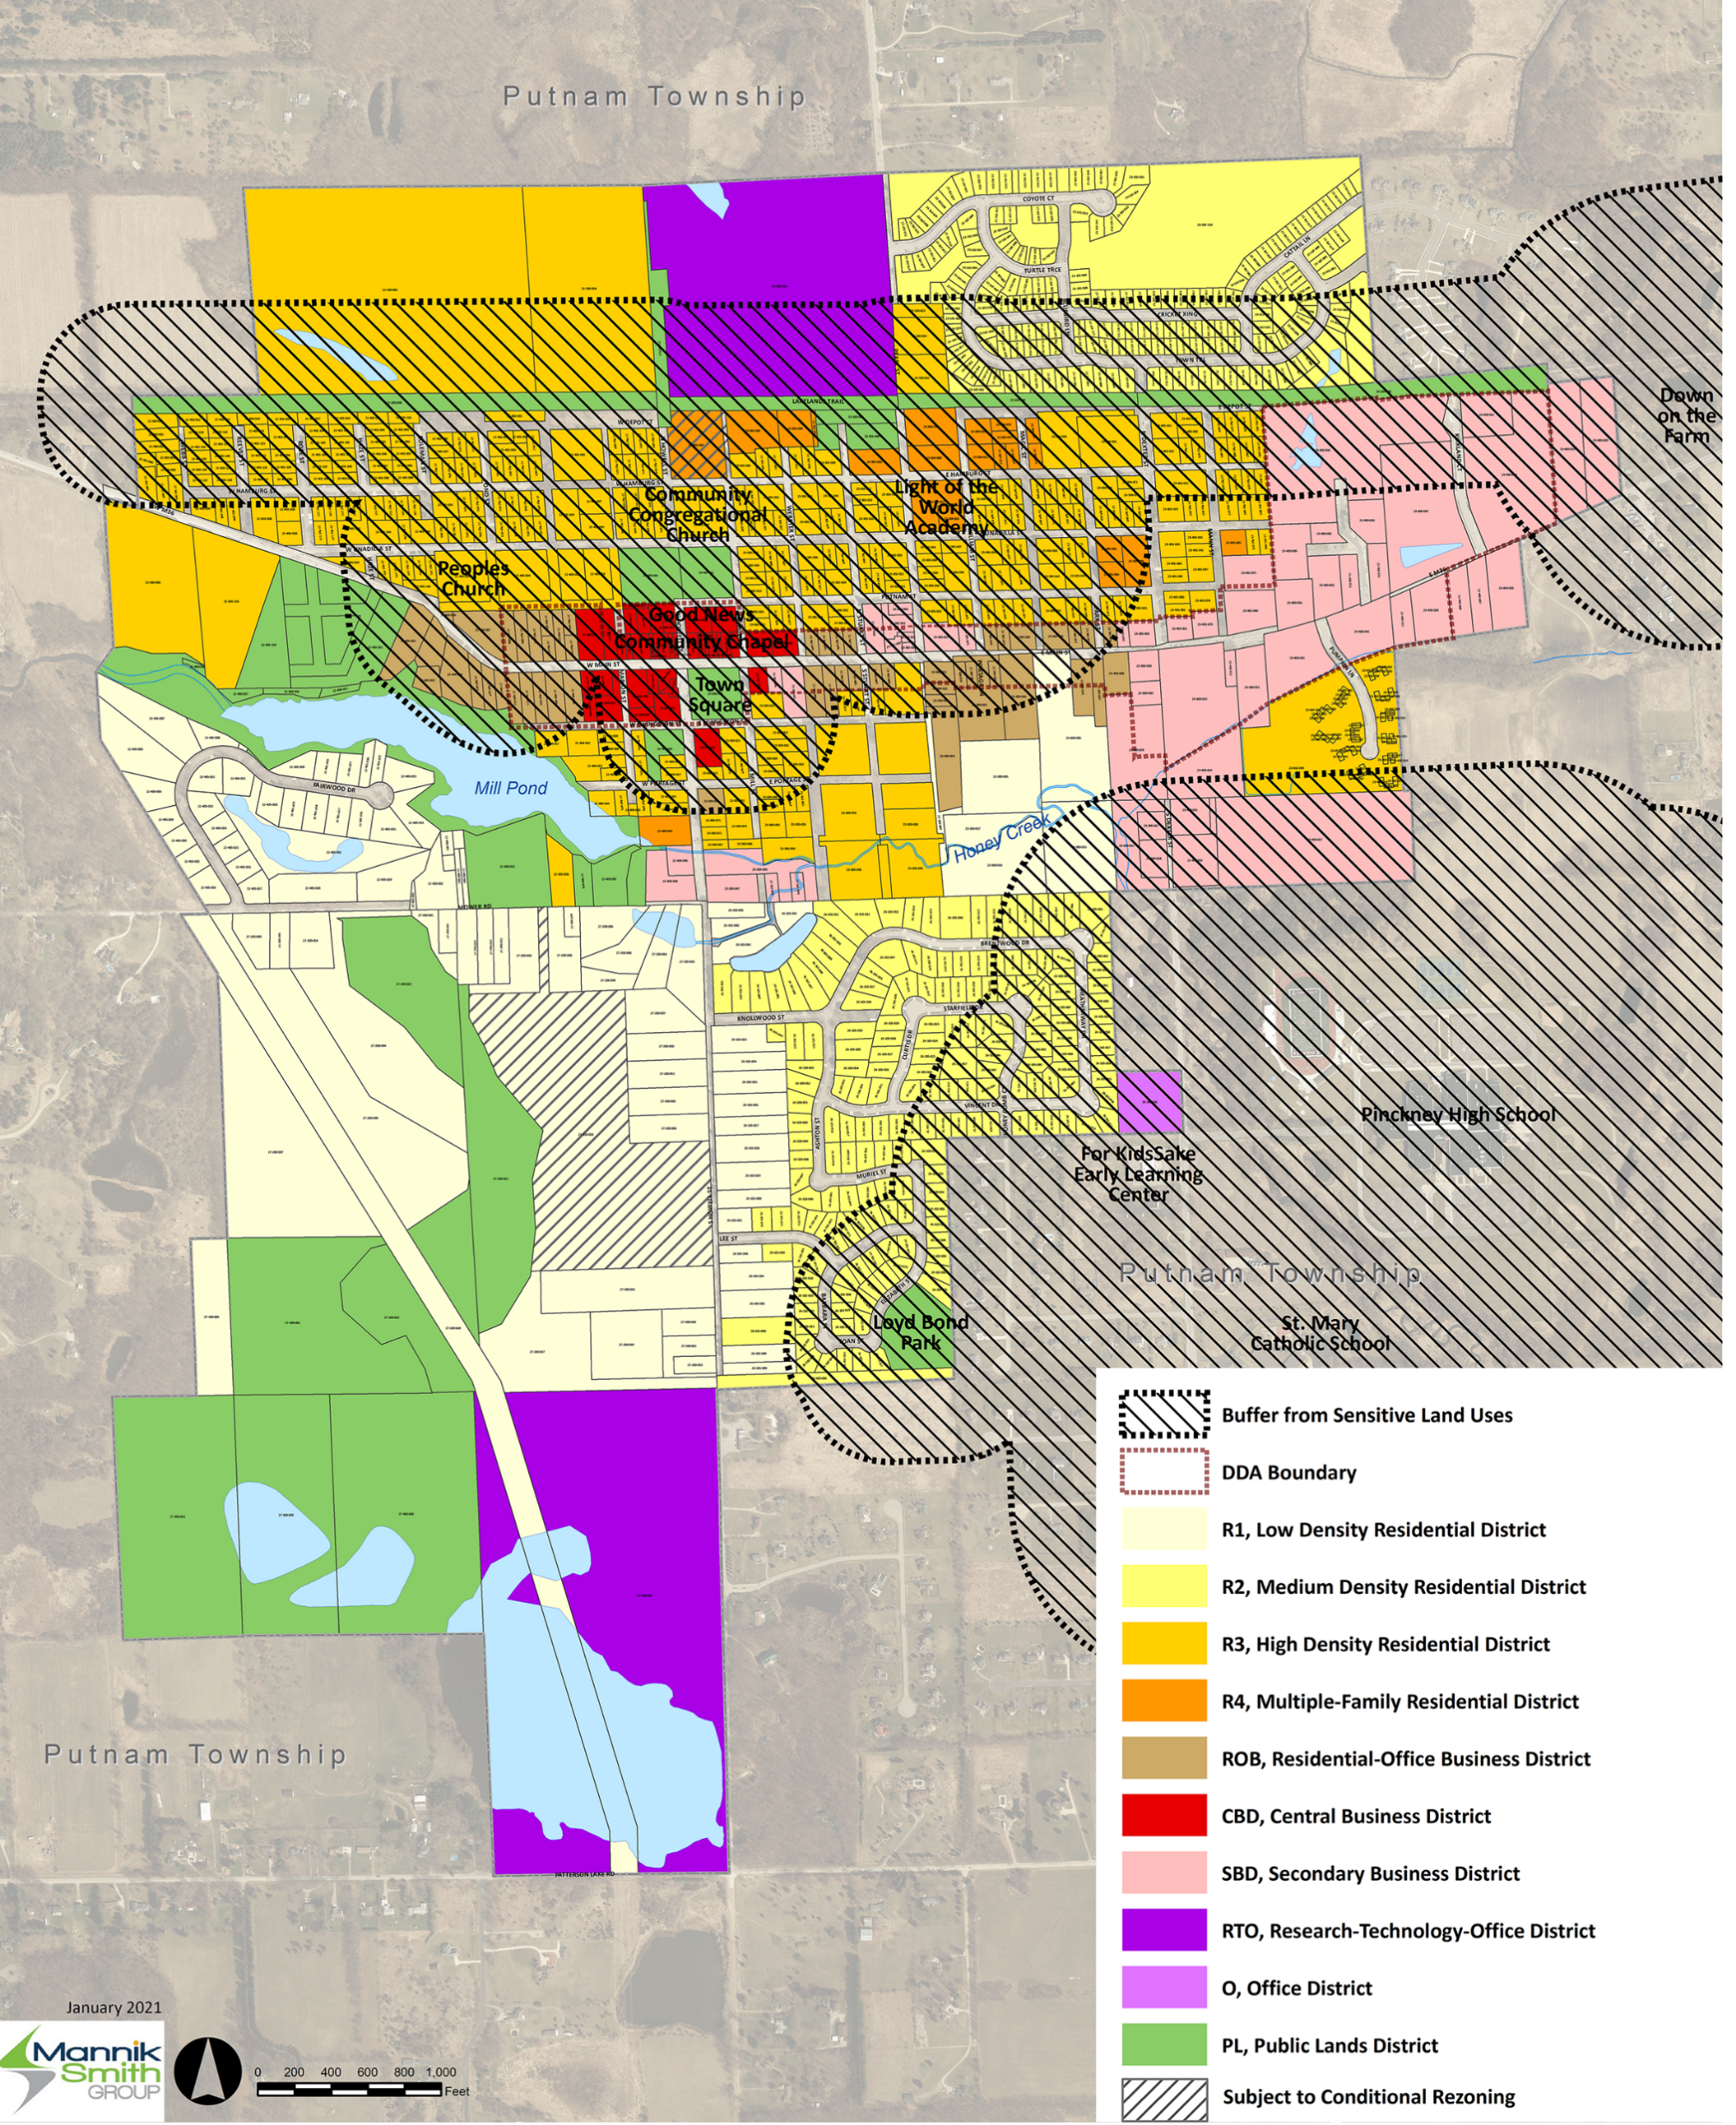
Buffer Map

Slide 9
Special Land Use Permit – Part A
Application Submittal Requirements
Village application form
Processing fee of $1,700
Preliminary site plan containing all the information required per Section 152.389 of the Village Zoning Ordinance
Written statement* explaining how the special land use comply with:
  The general criteria of Section 152.242 and
  The specific criteria of Section 152.243 (S)
  *Supported by preliminary site plan as applicable
Notes:
Just a general definition. Add other examples as desired.

Slide 10
Special Land Use Permit – Part A
General Approval Criteria of Section 152.242
Compliance with Village Master Plan
Compliance with Zoning District
Compatibility
Infrastructure and services
Traffic
Environmental performance
Natural resources
Architecture
Compliance Required
Notes:
Just a general definition. Add other examples as desired.

Slide 11
Special Land Use Permit – Part A
Specific Approval Criteria of Section 152.243 (S)
Compliance with prohibited uses
Pre-qualification approval from the State of Michigan
Permitted co-location and stacked licenses as applicable
Permitted hours of operation
Submittal of a security plan
Required road frontage and access
Appropriate separation distance from sensitive land uses
Proper enclosure and screening
Adequate environmental performance including odor plan
Water supply and sanitary sewerage facility impact
Preliminary sign design
Compliance with other site development standards
Notes:
Just a general definition. Add other examples as desired.

Slide 12
Village Recreational Adult Use Marihuana Business Provisional License – Part B
Application Submittal Requirements
Village application form
Processing fee of $5,000
Village special land use permit
Applicant entity articles of incorporation/organization/partnership Agreement
Location map with separation distance from sensitive land uses
Ownership documentation
Preliminary site plan containing all the information required per Section 152.389 of the Village Zoning Ordinance
Notes:
Just a general definition. Add other examples as desired.

Slide 13
Village Recreational Adult Use Marihuana Business Provisional License – Part B
Application Submittal Requirements (Continued)
Pre-qualification from the State of Michigan
Business Plan
Employee training and education plan
Facility sanitation plan
Security plan
Wastewater treatment plan
Signed statement of acknowledgment
Description of the number and type of jobs created
Signatory authorization documentation
Notes:
Just a general definition. Add other examples as desired.

